Slide 1

Next Hikes User Analytics in the Telecommunication Industry – Overview
Manila dugar

Slide 2

Analysis of Customer Handset Usage Top 10 Handsets Used by Customers
The dataset provides information on the handset types used by customers.
The analysis reveals the following top 10 handsets:
Huawei B528S-23A: 19,752 occurrences
Apple iPhone 6S (A1688): 9,419 occurrences
Apple iPhone 6 (A1586): 9,023 occurrences
Undefined: 8,987 occurrences
Apple iPhone 7 (A1778): 6,326 occurrences
Apple iPhone Se (A1723): 5,187 occurrences
Apple iPhone 8 (A1905): 4,993 occurrences
Apple iPhone Xr (A2105): 4,568 occurrences
Samsung Galaxy S8 (Sm-G950F): 4,520 occurrences
Apple iPhone X (A1901): 3,813 occurrences

Slide 3

Top 3 Handset Manufacturers
The analysis also includes the identification of the top handset manufacturers.
The dataset provides information on the top 3 handset manufacturers
Apple: 59,565 occurrences
Samsung: 40,839 occurrences
Huawei: 34,423 occurrences

Slide 4

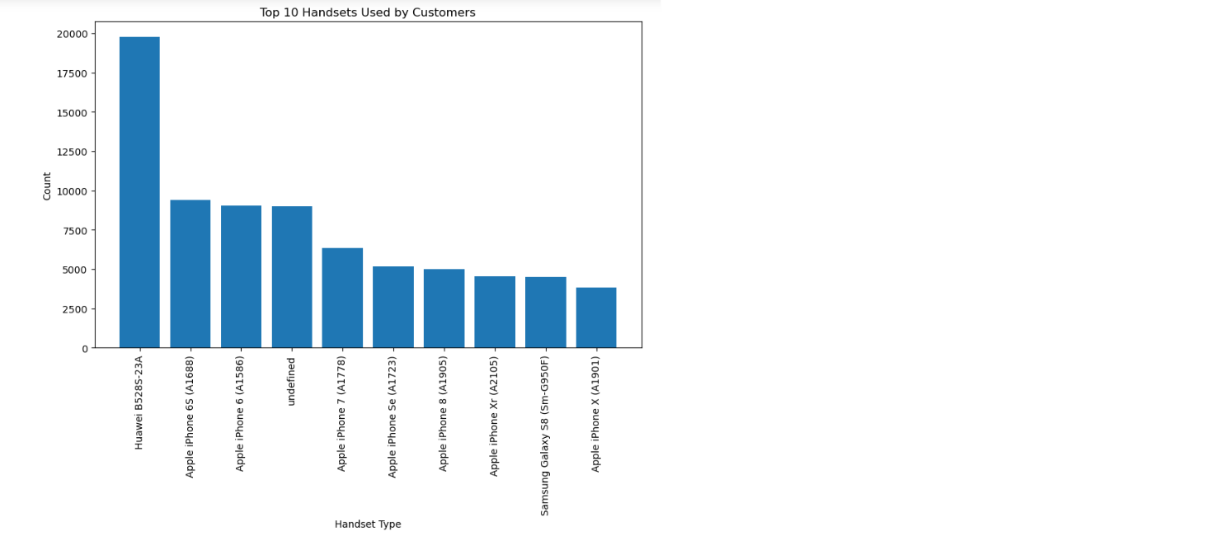
Implications and Recommendations
Understanding the most popular handsets and manufacturers helps inform decision-making.
Huawei B528S-23A is the most widely used handset, followed by various iPhone models.
Apple is the dominant handset manufacturer, with the highest number of occurrences indicates a strong preference among customers.
Samsung and Huawei also have a significant market share among customers.
Businesses should consider compatibility and optimization for Apple devices in their products and services.
Samsung and Huawei also have a substantial customer base, indicating potential market opportunities.
It is crucial to address the "undefined" category to improve data accuracy and analysis.
Apple, Samsung, and Huawei emerge as the top players in the market.

Slide 5

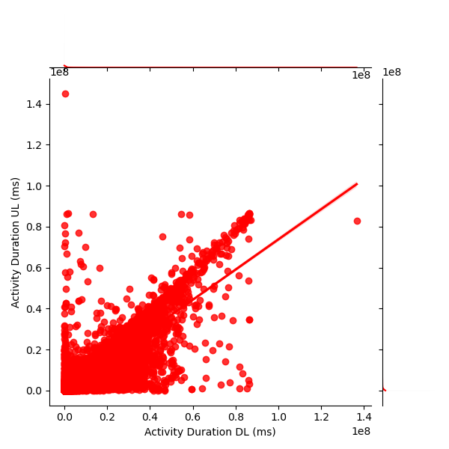
Analysis of User Data Usage
The data includes a wide range of durations, from very short (0.0 ms) to very long (e.g., 136,536,461.0 ms)
The regression line has a positive slope, it indicates a positive correlation between the variables, suggesting that as "Activity Duration DL (ms)" increases, "Activity Duration UL (ms)" also tends to increase.
The strength of the correlation can be determined by how closely the data points align around the regression line. If the data points cluster tightly around the line, it indicates a strong correlation

Slide 6
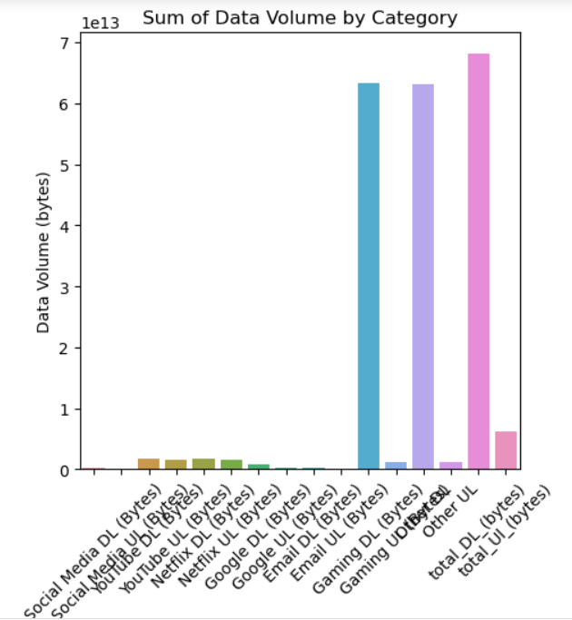
Sum of Data Volume by Category
The analysis reveals the total data volume by category.
The maximum data volume consumption is attributed to applications such as Total_DL_(Bytes), Gaming_UL_(Bytes), and Email_UL_(Bytes).
Understanding data consumption patterns can aid in managing resources effectively and optimizing data usage.

Slide 7

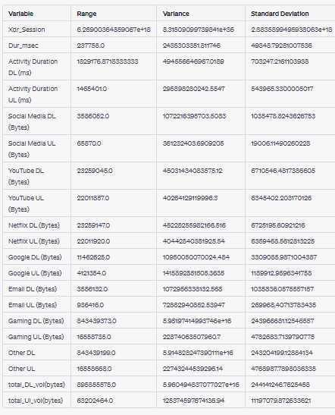
Non-Graphical Univariate Analysis

Slide 8
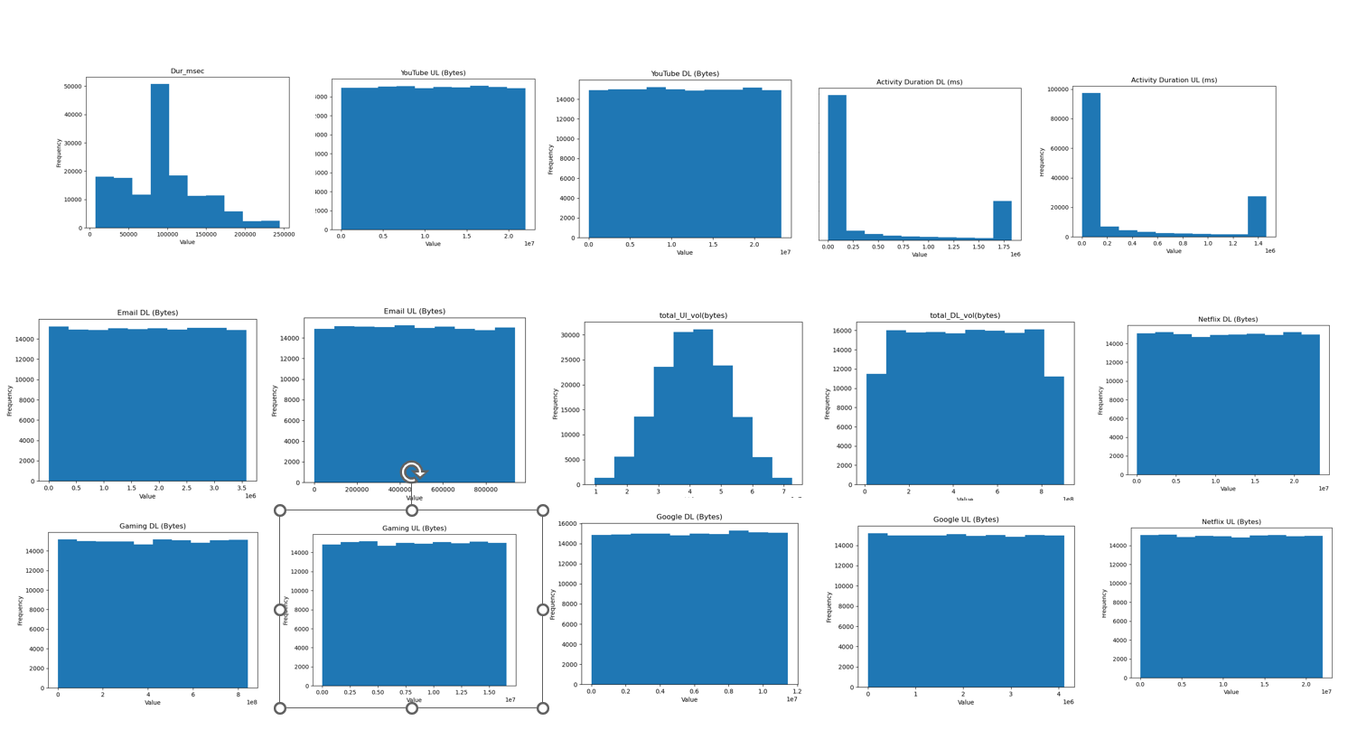
Graphical Univariate Analysis

Slide 9
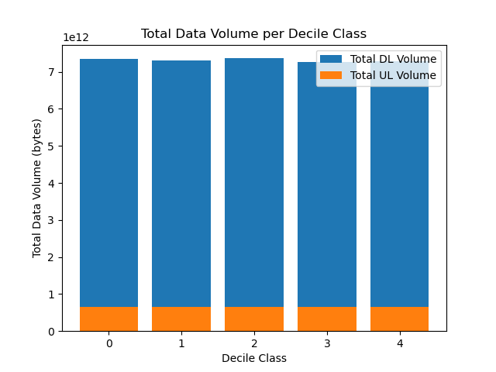
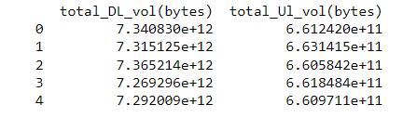
Bivariate Analysis
Compute total data (DL+UL) per decile class
This analysis allows you to understand the total duration of sessions per user and the distribution of total data (DL+UL) across decile classes
This analysis provides insights into the distribution of session durations and the total data volume for different decile classes of users. It helps identify patterns or trends related to user behavior and data consumption across decile groups.

Slide 10

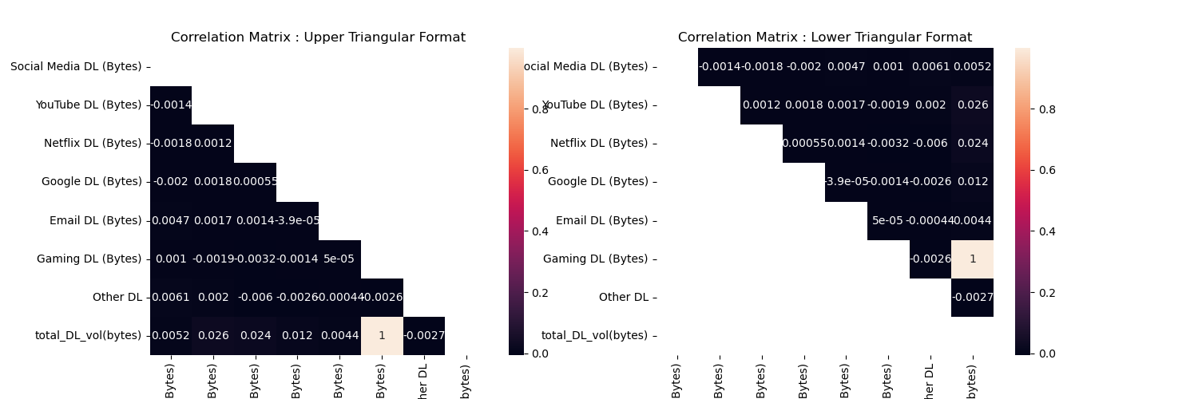
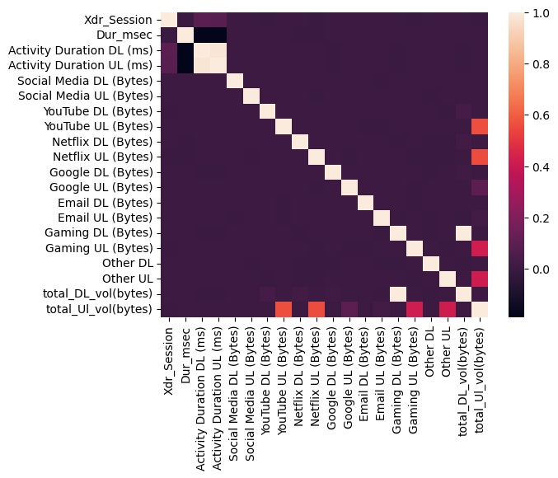
Correlation Matrix
the CoRrelation Between each application

Slide 11
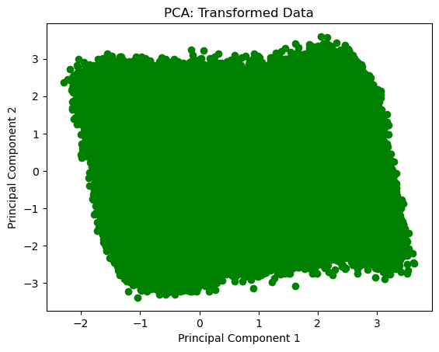
Dimensionality Reduction
Principal Component Analysis
The array of component loadings shows the correlation between the original features and the principal components. Larger absolute values in the loadings indicate a stronger relationship between the feature and the corresponding principal component.
The explained_variance_ratio array indicates the proportion of the total variance in the data explained by each principal component. In this case, the first principal component explains approximately 10.00% of the total variance, while the second principal component explains approximately 9.93% of the total variance. Together, these two components explain around 19.93% of the total variance.

Slide 12
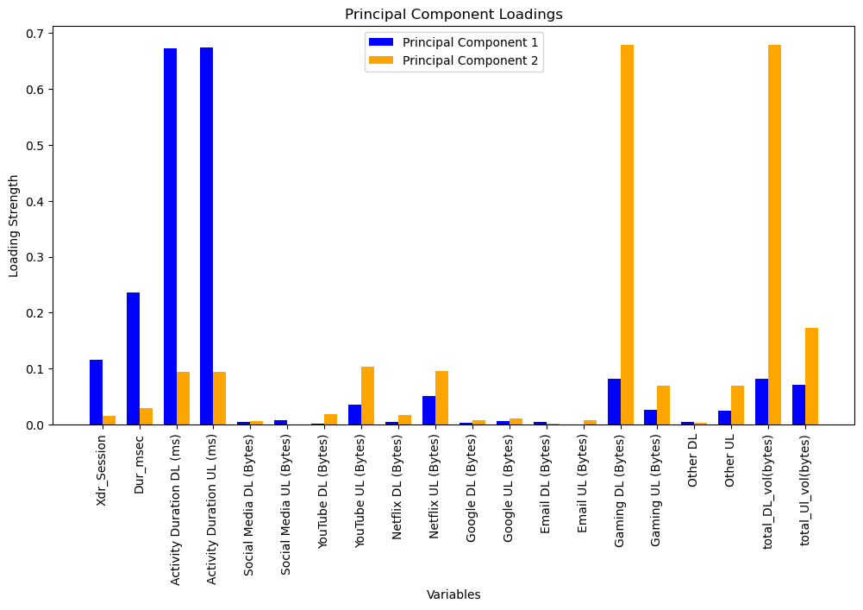
Get the loadings from the PCA
The bar plot provides a visual representation of the loading strengths for each variable in the principal components.
For Principal Component 1:
Variables with positive associations and higher strengths include: Activity Duration DL (ms), Activity Duration UL (ms), Netflix DL (Bytes), Netflix UL (Bytes), Other UL
Variables with negative associations & higher strengths include: Dur_msec, Social Media DL (Bytes), Google DL (Bytes), Email DL (Bytes), Gaming DL (Bytes), total_DL_vol(bytes)
For Principal Component 2:
Variables with positive associations and higher strengths include: Gaming DL (Bytes), total_DL_vol(bytes)
Variables with negative associations and higher strengths include: Dur_msec, YouTube UL (Bytes), Netflix UL (Bytes), Google UL (Bytes), Email UL (Bytes), Gaming UL (Bytes), Other DL, Other UL, total_Ul_vol(bytes)

Slide 13
Thank You

